Slide 1
Theory of Computation
Lesson14-1
Cook-Levin Theorem
王轩
Wang Xuan

Slide 2
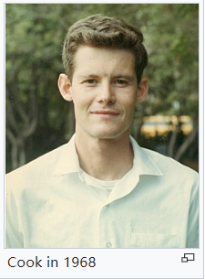
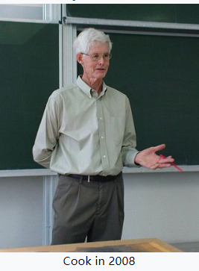
Cook-Levin theorem
Stephen Arthur Cook, born December 14, 1939 is an American-Canadian computer scientist and mathematician who has made major contributions to the fields of complexity theory and proof complexity.
Stephen Cook is considered one of the forefathers of computational complexity theory.During his PhD, Cook worked on complexity of functions, mainly on multiplication. In his seminal 1971 paper "The Complexity of Theorem Proving Procedures", Cook formalized the notions of polynomial-time reduction and NP-completeness, and proved the existence of an NP-complete problem by showing that the Boolean satisfiability problem (usually known as SAT) is NP-complete. This theorem was proven independently by Leonid Levin in the Soviet Union, and has thus been given the name the Cook-Levin theorem.
In 1982, Cook received the Turing award for his contributions to complexity theory.
Stephen Arthur Cook

Slide 3
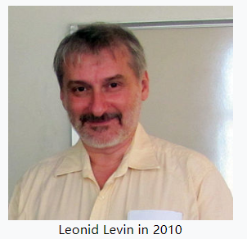
Cook-Levin theorem
Leonid Anatolievich Levin, born November 2, 1948 is a Soviet-American computer scientist.
He is known for his work in randomness in computing, algorithmic complexity and intractability, algorithmic probability, theory of computation, and information theory.
He and Stephen Cook independently discovered the existence of NP-complete problems. This NP-completeness theorem, often called the Cook–Levin theorem, was a basis for one of the seven Millennium Prize Problems declared by the Clay Mathematics Institute with a $1,000,000 prize offered. The Cook–Levin theorem was a breakthrough in computer science and an important step in the development of the theory of computational complexity.
Levin was awarded the Knuth Prize in 2012 for his discovery of NP-completeness and the development of average-case complexity.
Leonid Levin

Slide 4
Cook-Levin theorem
Theorem (Cook-Levin): SAT is NP-complete
Corollary: SAT ∈ P if and only if P = NP

Slide 5
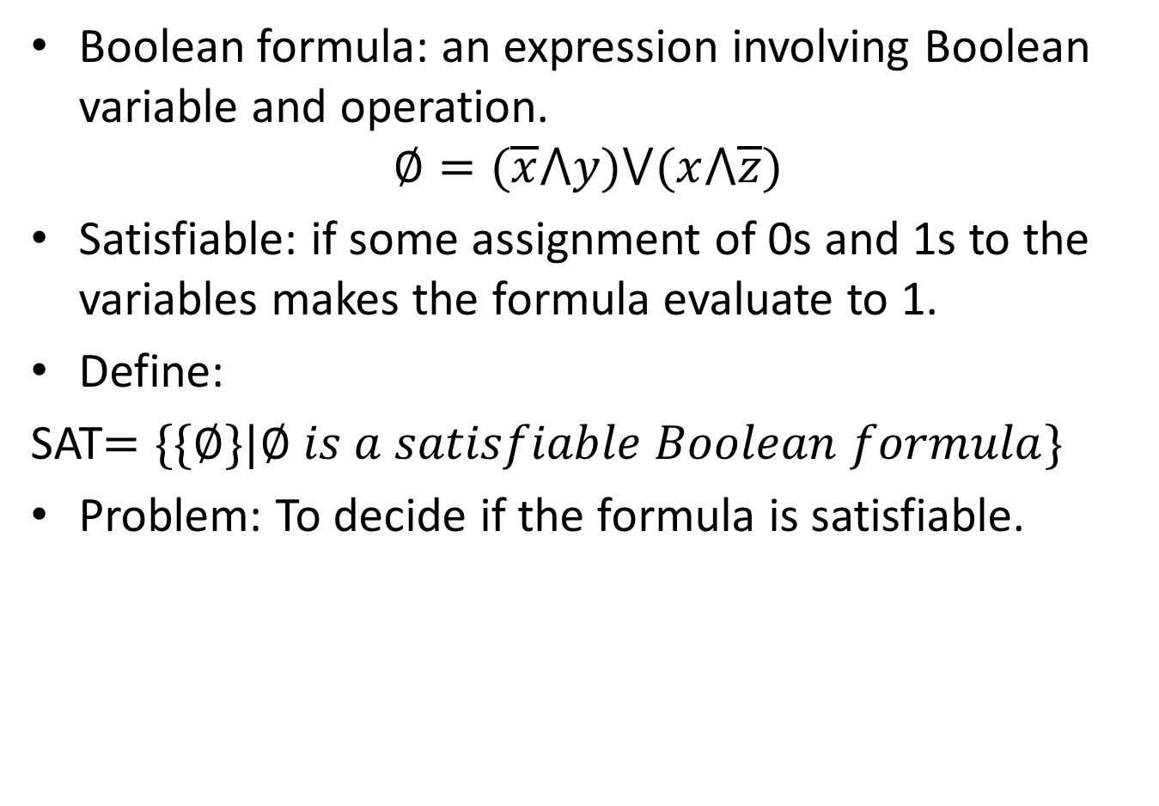
SAT
Boolean formula: an expression involving Boolean variable and operation.
$$∅=(\overline{x}⋀y)⋁(x⋀\overline{z})$$
Satisfiable: if some assignment of 0s and 1s to the variables makes the formula evaluate to 1.
Define:
SAT$=\{\{∅\}|∅ is a satisfiable Boolean formula\}$
Problem: To decide if the formula is satisfiable.

Slide 6
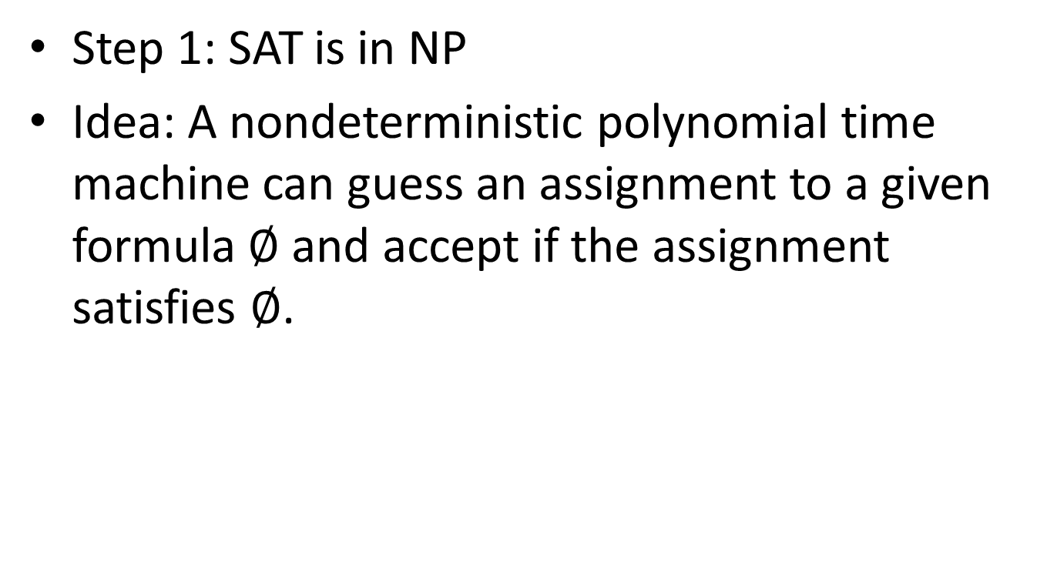
Proof
Step 1: SAT is in NP
Idea: A nondeterministic polynomial time machine can guess an assignment to a given formula $∅$ and accept if the assignment satisfies $∅$.

Slide 7
Proof
Step 2: SAT is NPC
Proof idea:
For any NP machine M and any input string w, we construct a Boolean formula ϕ_{M,w} which is satisfiable iff M accepts w.

Slide 8
Representing a Computation by a Configurations Table
n^{k}
_
q₀
w₁
w_{n}
upper bound on
the running time
the content of the (relevant part of the) tape
and the position of the head
n^{k}
indicates tape bounds

Slide 9
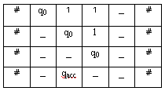
Tableau: Example
TM:
Q={q₀,q_{accept},q_{reject}}
Σ={1}
Γ={1,_}
δ(q₀,1)={(q₀,_,R)}
δ(q₀,_)={(q_{accept},L)}
tableau (input 11)
Q: what does this machine compute?

Slide 10
The Variables of the Formula
stands for: “Is s the content of cell (i,j)?”
x_{i, j, s}
symbol (s∈Γ∪Q∪{#})
position in the tableau (1≤i,j≤n^{k})

Slide 11
The Formula ϕ
ϕ_{M,w} = φ_{cell} ∧ φ_{start} ∧ φ_{move} ∧ φ_{accept}
cell content consistency
machine accepts
input consistency
transition legal

Slide 12
Ensuring Unique Cell Content
The (i,j) cell must contain some symbol
It shouldn’t contain different symbols.
!
Note: the length of this formula is polynomial in n.

Slide 13
Ensuring Initial Configuration Corresponds to Input
Observe: we can explicitly state the desired configuration in the first step. Assuming the input string is w₁w₂...w_{n},

Slide 14
Ensuring the Computation Accepts
The accepting state is visited during the computation.

Slide 15
Ensuring Every Transition is Legal
Local: only need
to examine
2×3 “windows”

Slide 16
Ensuring Every Transition is Legal
for any a₁,...,a₆ s.t. this is a legal window
a₁
a₂
a₃
a₄
a₅
a₆

Slide 17












Which Windows are Legal in the Following Example?
TM:
Q={q₀,q_{accept},q_{reject}}
Σ={1}
Γ={1,_}
δ(q₀,1)={(q₀,_,R)}
δ(q₀,_)={(q_{accept},L)}
✗
✓
✓
✓
✗
✓

Slide 18
The Bottom Line
ϕ_{M,w} = φ_{cell} ∧ φ_{start} ∧ φ_{move} ∧ φ_{accept}
ϕ, which is of size polynomial in n - Check! - is satisfiable iff the TM accepts the input string.

Slide 19
Conclusion: SAT is NP-Complete
For any language A in NP,
testing
membership in A
satisfiability
problem
can be reduced to...

Slide 20
Looking Forward
From now on, in order to show some NP problem is NP-Complete, we merely need to reduce SAT to it.
any NP
problem
can be reduced to...
SAT
can be reduced to...
We’ve already shown this
new NP
problem
will imply the new problem is in NPC

Slide 21
... and Beyond!
Moreover, every NP-Complete problem we discover, provides us with a new way for showing problems to be NP-Complete.
any NP
problem
can be reduced to...
Known
NP-hard
problem
can be reduced to...
new NP
problem

Slide 22
Any thing in NP ≤_{P} SAT
NP
P
SAT
You can think of -> as “easier than”. SAT is the hardest problem in NP.

Slide 23
3SAT
3SAT =
{ φ | ∃y such that y is a satisfying assigment to φ and φ is in 3cnf }
Problem: Given a CNF where each clause has 3 variables, decide whether it is satisfiable or not.
(x₁ ∨ x₁ ∨ x₂) ∧ (¬x₁ ∨ ¬x₂ ∨ ¬x₂) ∧ (¬x₁ ∨ x₂ ∨ x₂)

Slide 24
Proof
Idea:
We can convert (in polynomial time) a given SAT instance S into a 3SAT instance S’ such that
If S is satisfiable, then S’ is satisfiable.
If S’ is satisfiable, then S is satisfiable.
Key Observation:
x₁ ∨ x₂ ∨ x₃ ∨ x₄ ∨ x₅ is satisfiable
if and only if
(x₁ ∨ x₂ ∨ z₁)∧ ( ¬ z₁ ∨ x₃ ∨ z₂ )∧(¬ z₂ ∨ x₄ ∨ z₃)∧ (¬ z₃ ∨ x₄ ∨ x₅)
is satisfiable.

Slide 25
Polynomial Time Reduction
Clause in SAT
Clauses in 3SAT
x1 ∨ x1 ∨ x1
x1 ∨ x1 ∨ ¬ x2
x1 ∨ x2 ∨ x3
(x1 ∨ x2 ∨ z1)∧ ( ¬ z1 ∨ x3 ∨ x4)
(x1 ∨ x2 ∨ z1)∧ ( ¬ z1 ∨ x3 ∨ z2)∧
(¬ z2 ∨ x4 ∨ z3)∧ (¬ z3∨ x4 ∨ x5)
x₁
x₁ ∨ ¬ x₂
x₁ ∨ x₂ ∨ x₃
x₁ ∨ x₂ ∨ x₃ ∨ x₄
x₁ ∨ x₂ ∨ x₃ ∨ x₄ ∨ x₅

Slide 26
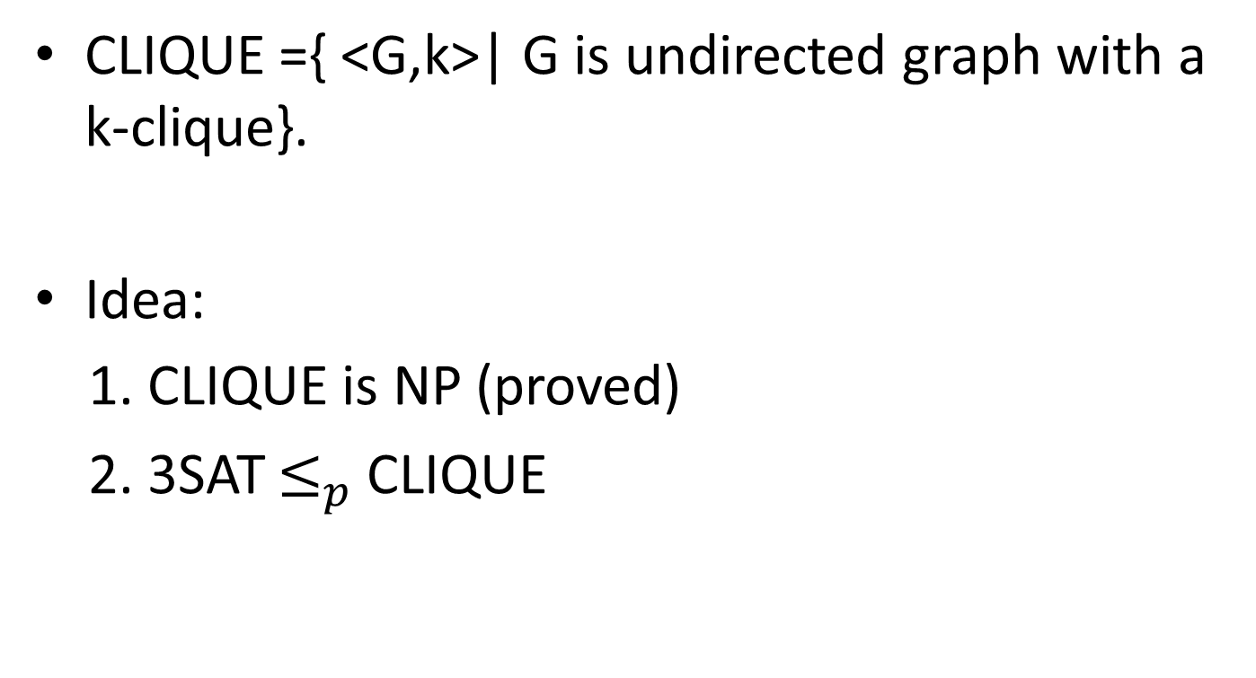
CLIQUE is NPC
CLIQUE ={ <G,k>| G is undirected graph with a k-clique}.
Idea:
1. CLIQUE is NP (proved)
2. 3SAT $≤_{p}$ CLIQUE
Brute Force Algorithm:
Try out all {n choose k} possible locations for the
k clique

Slide 27
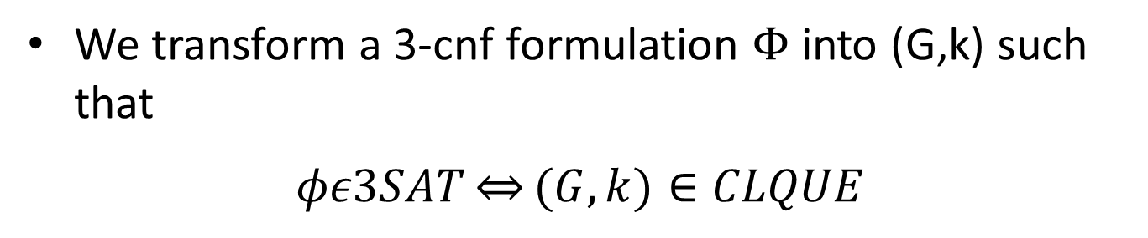

3SAT $≤_{p}$ CLIQUE
We transform a 3-cnf formulation $Φ$into (G,k) such that
$$φε3SAT\underset{⇔}{}(G,k)∈CLQUE$$
If φ has m clauses, we create a graph with m clusters of 3 nodes each, and set k=m
---Each cluster corresponds to a clause.
---Each node in a cluster is labeled with a literal from the clause.
We do not connect any nodes in the same cluster. We connect nodes in different clusters whenever they are not contradictory

Slide 28
(x₁ ∨ x₁ ∨ x₂) ∧ (¬x₁ ∨ ¬x₂ ∨ ¬x₂) ∧ (¬x₁ ∨ x₂ ∨ x₂)
¬x₁
¬x₂
¬x₂
clause
x₁
¬x₁
x₁
x₂
x₂
x₂
#nodes = 3(# clauses)
k = #clauses

Slide 29
(x₁ ∨ x₁ ∨ x₁) ∧ (¬x₁ ∨ ¬x₁ ∨ x₂) ∧
(x₂ ∨ x₂ ∨ x₂) ∧ (¬x₂ ∨ ¬x₂ ∨ x₁)
¬x₁
¬x₁
x₂
x₁
x₂
x₁
x₂
x₁
x₂
¬x₂
¬x₂
x₁

Slide 30
Other NP-Complete Problem
Vertex Cover
Max Cut

